Slide 1
Agenda
Summary of last class
  Loops
    Simple Loops
    WHILE Loops
    FOR Loops
  Records
Cursors

Slide 2
Records
User-defined composite types
Provides a way to treat separate but logically related variables as a unit
Similar to “structures” in C
Use the dot notation to refer to fields within a record
  v_StudentInfo.FirstName := ‘John’;
In order to copy one record to another record, both records must be of the same record type

Slide 3
Records
Syntax:
  DECLARE
  TYPE t_StudentRecord IS RECORD(
  Student_ID NUMBER(5),
  FirstName VARCHAR2(20),
  LastName VARCHAR2(20) );
  v_StudentInfo t_StudentRecord;
  BEGIN
  -- Process data here
  EXCEPTION
  -- Error handling would go here
  END;
  /
Use the dot notation to refer to fields within a record.
Example:
v_StudentInfo.FirstName := ‘John’;

Slide 4
Records
To declare a record with the same structure (i.e. fields & field types) as a database row, use %ROWTYPE
Syntax:
  DECLARE
  v_StudentInfo student%ROWTYPE;
  BEGIN
  -- Process data here
  EXCEPTION
  -- Error handling would go here
  END;
  /
NOTE:
Any NOT NULL constraints that are defined for a column within the table will not be applicable to the declared record when %ROWTYPE is used.

Slide 5
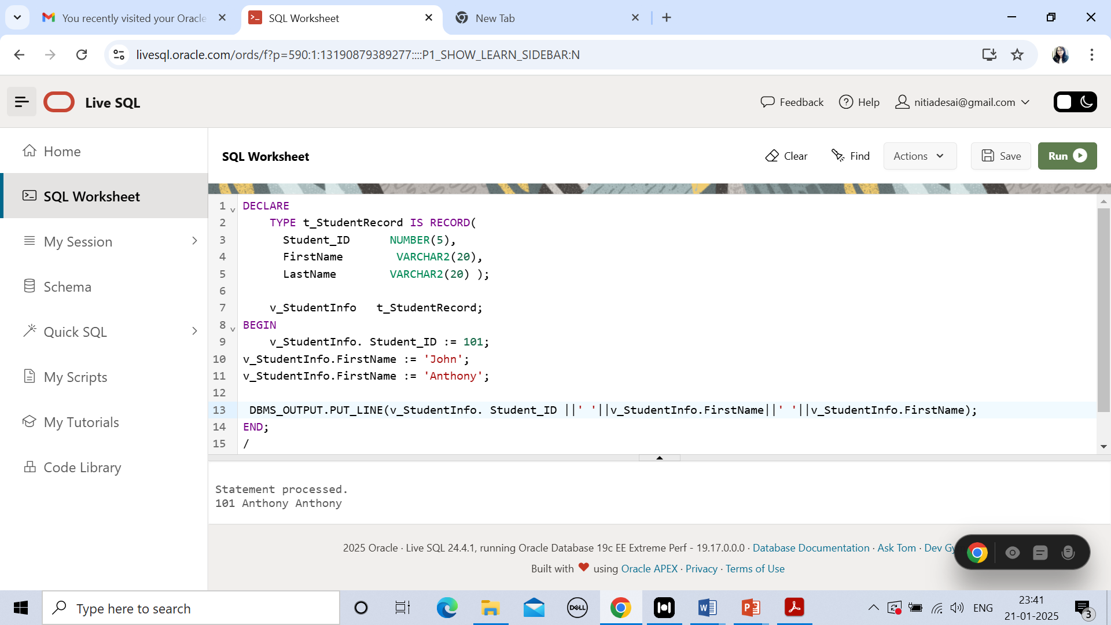


Slide 6
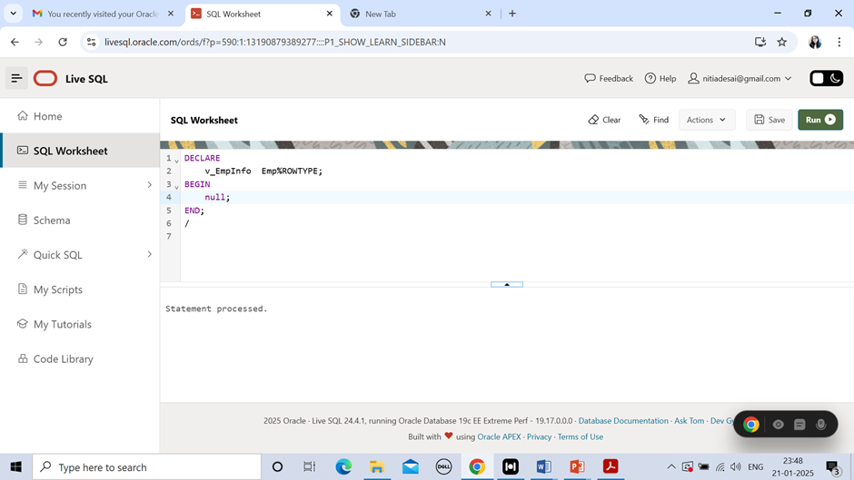

Slide 7
%TYPE attribute
variable_name {other_variable_name | table_name.column_name}%TYPE
%ROWTYPE attribute:
variable_name \table_name%ROWTYPE variable_name QUERY LIKE table_name%ROWTYPE

Slide 8
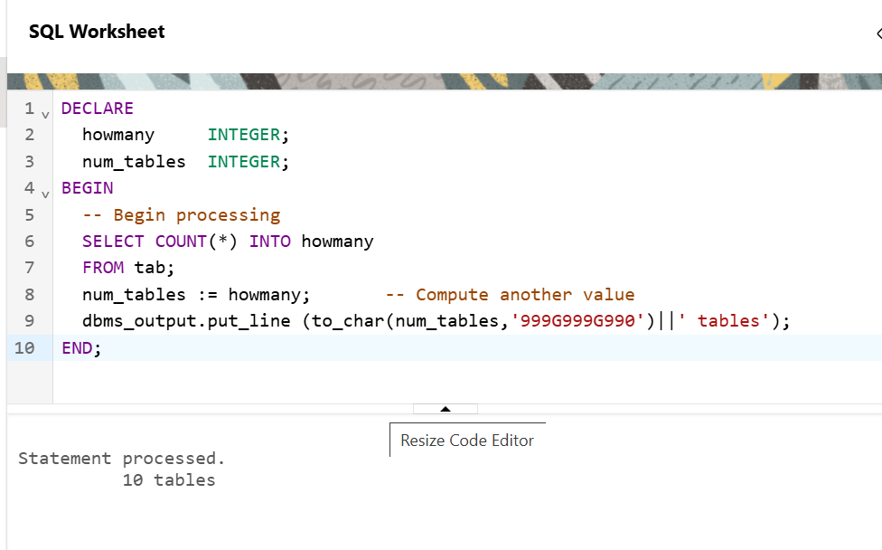
Select * from tab;

Slide 9
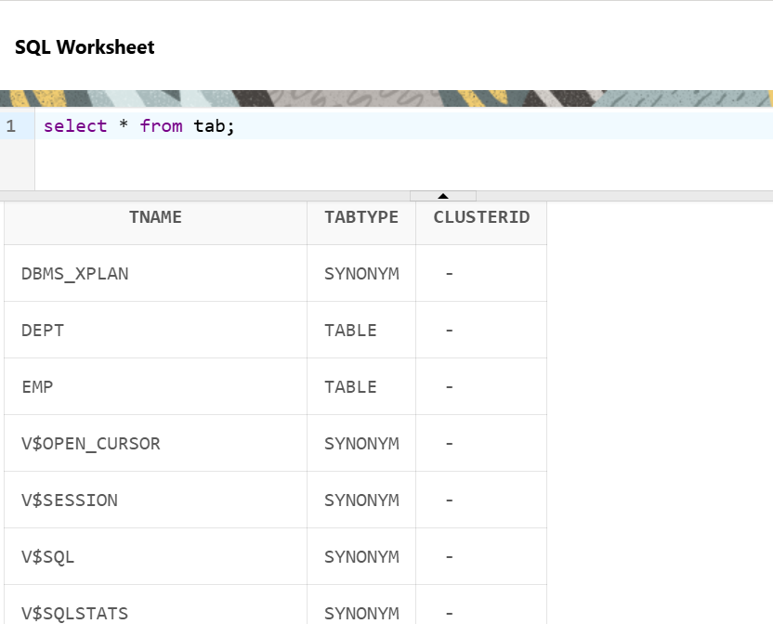

Slide 10
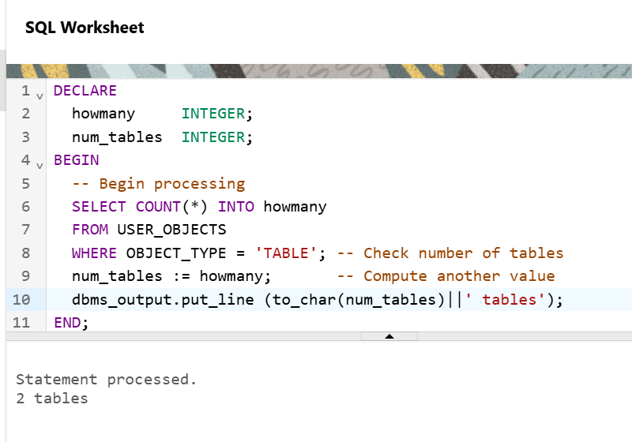

Slide 11
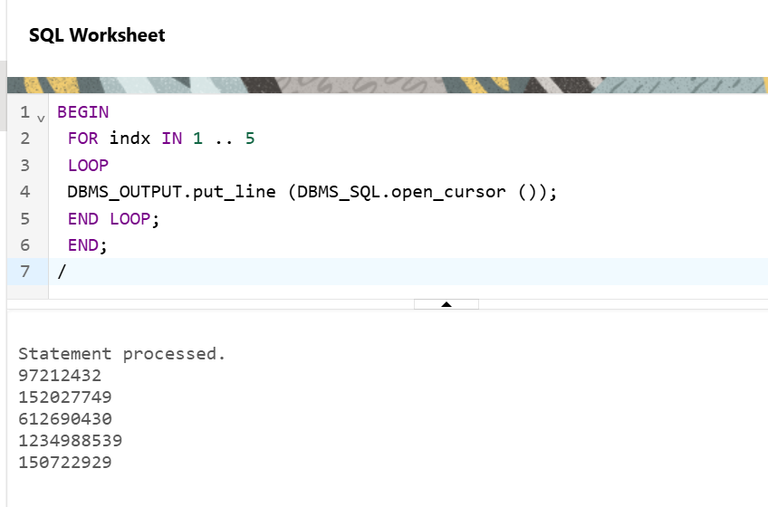
DBMS_SQL.OPEN_CURSOR returned a sequentially incremented number

Slide 12
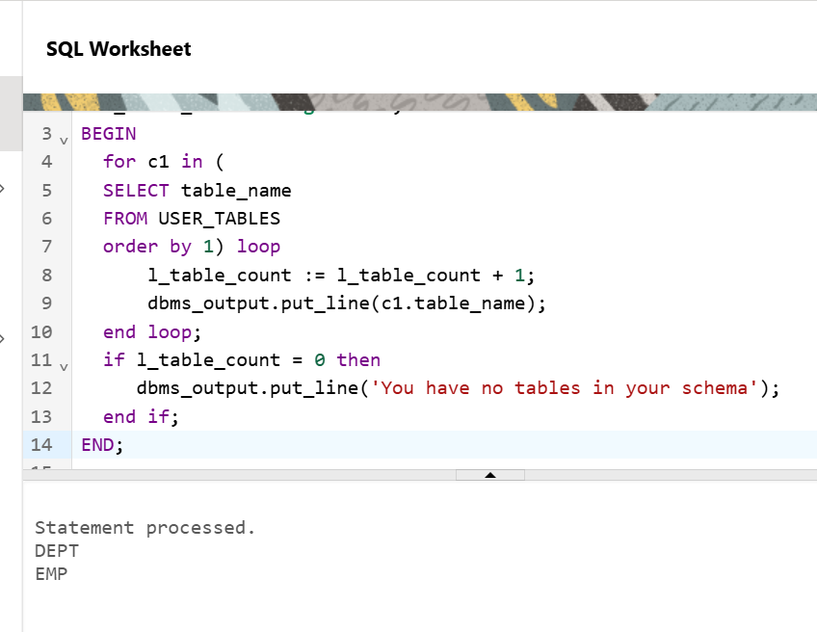

Slide 13
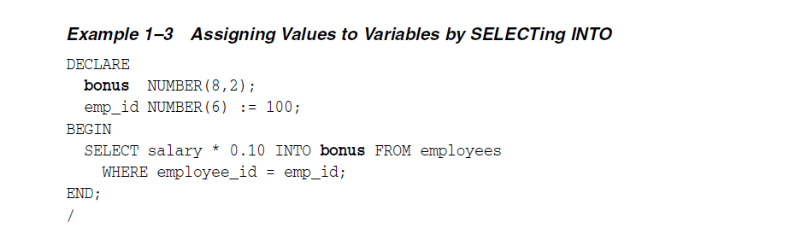

Slide 14
cursor
In PL/SQL, a cursor is a pointer that helps you retrieve multiple rows from a database query one at a time.
Cursors are commonly used in cases where you need to process each row of a query individually, rather than retrieving all the rows at once.

Slide 15
Types of cursors in PL/SQL
Implicit Cursor: Automatically created by Oracle for SQL statements like SELECT INTO, INSERT, UPDATE, and DELETE that return a single result set. You don't need to explicitly declare or manage them.
Explicit Cursor: You declare and control the cursor manually. This is used when you want to process multiple rows from a SELECT query.

Slide 17
Cursors
A pointer to the context area
Context area contains:
  Number of rows processed by the statement
  A pointer to the parsed representation of the statement
  In the case of a query, the set of rows returned by the query (i.e. the active set, active recordset)
Follows standard declaration and scoping
Naming Convention: c_CursorName
Cursor Types:
  Explicit: user-defined
  Implicit: system-defined

Slide 18
Explicit Cursors
To use explicit cursors…
  Declare the cursor
  Open the cursor
  Fetch the results into PL/SQL variables
  Close the cursor

Slide 19
Declaring Cursors
DECLARE
v_StudentID students.id%TYPE;
v_FirstName students.first_name%TYPE;
v_LastName students.last_name%TYPE;
CURSOR c_HistoryStudents IS
SELECT id, first_name, last_name
FROM students
WHERE major = ‘History’;
BEGIN
-- open cursor, fetch records & then close cursor here
END;
/

Slide 20
OPEN Cursor
DECLARE
v_StudentID students.id%TYPE;
v_FirstName students.first_name%TYPE;
v_LastName students.last_name%TYPE;
CURSOR c_HistoryStudents IS
SELECT id, first_name, last_name
FROM students
WHERE major = ‘History’;
BEGIN
OPEN c_HistoryStudents;
-- fetch records & then close cursor here
END;
/

Slide 21
FETCH Records
DECLARE
v_StudentID students.id%TYPE;
v_FirstName students.first_name%TYPE;
v_LastName students.last_name%TYPE;
CURSOR c_HistoryStudents IS
SELECT id, first_name, last_name
FROM students
WHERE major = ‘History’;
BEGIN
OPEN c_HistoryStudents;
LOOP
FETCH c_HistoryStudents INTO v_StudentID, v_FirstName, v_LastName;
EXIT WHEN c_HistoryStudents%NOTFOUND;
-- do something with the values that are now in the variables
END LOOP
-- close cursor here
END;/

Slide 22
Close Cursor
DECLARE
v_StudentID students.id%TYPE;
v_FirstName students.first_name%TYPE;
v_LastName students.last_name%TYPE;
CURSOR c_HistoryStudents IS
SELECT id, first_name, last_name
FROM students
WHERE major = ‘History’;
BEGIN
OPEN c_HistoryStudents;
LOOP
FETCH c_HistoryStudents INTO v_StudentID, v_FirstName, v_LastName;
DBMS_OUTPUT.PUT_LINE(v_StudentID, v_FirstName, v_LastName);
EXIT WHEN c_HistoryStudents%NOTFOUND;
-- do something with the values that are now stored in the variables
END LOOP
CLOSE c_HistoryStudents;
END; /

Slide 23
Cursor Attributes
Cursors have four attributes…
  %FOUND
    TRUE if the previous FETCH returned a row
    Otherwise, FALSE
  %NOTFOUND
    TRUE if the previous FETCH did NOT return a row
    Otherwise, FALSE
  %ISOPEN
    TRUE if the cursor is open,
    Otherwise, FALSE
  %ROWCOUNT
    Returns the # of rows that have been fetched by the cursor so far

Slide 24
Cursor Fetch Loop: WHILE Loop
DECLARE
CURSOR c_HistoryStudents IS
SELECT id, first_name, last_name
FROM students
WHERE major = 'History';
v_StudentData c_HistoryStudents%ROWTYPE;
BEGIN
OPEN c_HistoryStudents;
FETCH c_HistoryStudents INTO v_StudentData;
WHILE c_HistoryStudents%FOUND LOOP
INSERT INTO registered_students (student_id, department, course)
VALUES (v_StudentData.ID, 'HIS', 301);
INSERT INTO temp_table (num_col, char_col)
VALUES (v_StudentData.ID, v_StudentData.first_name || ' ' || v_StudentData.last_name);
FETCH c_HistoryStudents INTO v_StudentData;
END LOOP;
CLOSE c_HistoryStudents;
END;/

Slide 25
Take Home Exercise #1
Write an anonymous PL/SQL block that…
  Defines a cursor that points to a record set that contains the sailors’ names, reservation date and boat id where the boat color is red
  Opens the cursor
  Uses a simple loop to fetch each record in the active set
  Displays each last name, reservation date and boat id for each record to the output screen
  Schema
  Sailor (sid, sname, rating, age)
  Boat (bid, bname, color)
  Reservation(sid, bid, day)

Slide 26
Cursor with Bind Variable(s)
DECLARE
v_StudentID students.id%TYPE;
v_FirstName students.first_name%TYPE;
v_LastName students.last_name%TYPE;
v_Major students.major%TYPE;
CURSOR c_HistoryStudents IS
SELECT id, first_name, last_name
FROM students
WHERE major = v_Major;
BEGIN
v_Major := ‘History’;
OPEN c_HistoryStudents;
LOOP
FETCH c_HistoryStudents INTO v_StudentID, v_FirstName, v_LastName;
EXIT WHEN c_HistoryStudents%NOTFOUND;
-- do something with the values that are now stored in the variables
END LOOP
CLOSE c_HistoryStudents;
END; /

Slide 27
Bind Variables
What are bind variables?
  Variables that are referenced in the cursor declaration
  They must be declared BEFORE the cursor is declared
    i.e. variable must be declared before it can be used
  The values of bind variables are examined ONLY when the cursor is opened (at run time)

Slide 28
Explicit Cursors with Bind Variables
To use explicit cursors with bind variables…
  Declare bind variables
  Then declare the cursor
  Assign values to bind variables
  Open the cursor
  Fetch the results into PL/SQL variables
  Close the cursor

Slide 29
Take Home Exercise #2
Modify your answer for Class Exercise #1 such that…
  It uses bind variables for color of boat instead of hard-coding the values in the WHERE clause
  The FETCH is done inside of a WHILE loop instead of inside of a simple loop.

Slide 30
Implicit Cursors
Used for INSERT, UPDATE, DELETE and SELECT…INTO queries
  In SQL%NOTFOUND, SQL is called the implicit cursor
  PL/SQL opens & closes implicit cursors, which is also called SQL cursor
  You don’t declare the implicit cursor
  If the WHERE clause fails…
    For SELECT…INTO statement, then NO_DATA_FOUND error is raised instead of SQL%NOTFOUND
    For UPDATEs and DELETEs, SQL%NOTFOUND is set to TRUE

Slide 31
Example of Implicit Cursor
BEGIN
UPDATE rooms
SET number_seats = 100
WHERE room_id = 99980;
-- If the previous UPDATE statement didn't match any rows,
-- insert a new row into the rooms table.
IF SQL%NOTFOUND THEN
INSERT INTO rooms (room_id, number_seats)
VALUES (99980, 100);
END IF;
END;
/

Slide 32
Example of Implicit Cursor
BEGIN
UPDATE rooms
SET number_seats = 100
WHERE room_id = 99980;
-- If the previous UPDATE statement didn't match any rows,
-- insert a new row into the rooms table.
IF SQL%ROWCOUNT = 0 THEN
INSERT INTO rooms (room_id, number_seats)
VALUES (99980, 100);
END IF;
END;

Slide 33
-- Example of SELECT…INTO and NO_DATA_FOUND
set serveroutput on
DECLARE
-- Record to hold room information.
v_RoomData rooms%ROWTYPE;
BEGIN
-- Retrieve information about room ID -1.
SELECT *
INTO v_RoomData
FROM rooms
WHERE room_id = -1;
-- The following statement will never be executed, since
-- control passes immediately to the exception handler.
IF SQL%NOTFOUND THEN
DBMS_OUTPUT.PUT_LINE('SQL%NOTFOUND is true!');
END IF;
EXCEPTION
WHEN NO_DATA_FOUND THEN
DBMS_OUTPUT.PUT_LINE('NO_DATA_FOUND raised!');
END;
/

Slide 34
SHOW ERRORS
To display error message
SQL> SHOW ERRORS;

Slide 35
Summary of last class
Cursors
  A pointer to the context area (active set)
  Name begins with c_
  Defined within the DECLARE section
  Types: Explicit vs. Implicit
    Explicit: (1) Declare, (2) Open, (3) Fetch & (4) Close
  Bind variables
    Variables that are referenced in the cursor declaration
    Must be defined BEFORE the cursor
    Values examined ONLY at run time
CURSOR c_HistoryStudents IS
SELECT id, first_name, last_name
FROM students
WHERE major = ‘History’;

Slide 36
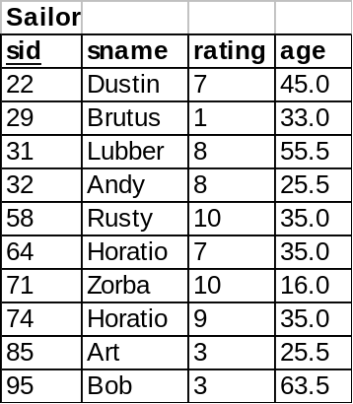
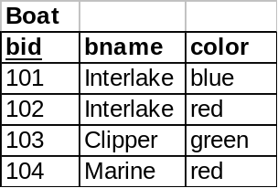
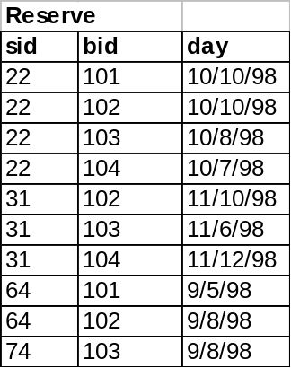
Take Home Exercise #1
DECLARE
CURSOR c_Reservations IS
SELECT s.sname, r.day, r.bid
FROM Sailor S, Reserve R, Boat B
WHERE R.sid = s.sid
AND R.bid = b.bid
AND B.color = ‘red’;
v_Reservation c_Reservations%ROWTYPE;
BEGIN
OPEN c_Reservations;
LOOP
FETCH c_Reservations INTO v_Reservation;
EXIT WHEN c_Reservations%NOTFOUND;
DBMS_OUTPUT.PUT_LINE(v_Reservation.sname||’ ‘||v_Reservation.day||’ v_Reservation.bid);
END LOOP;
CLOSE c_Reservations;
END;/

Slide 37
Cursor Attributes
Cursors have four attributes…
  %FOUND
    TRUE if the previous FETCH returned a row
    Otherwise, FALSE
  %NOTFOUND
    TRUE if the previous FETCH did NOT return a row
    Otherwise, FALSE
  %ISOPEN
    TRUE if the cursor is open,
    Otherwise, FALSE
  %ROWCOUNT
    Returns the # of rows that have been fetched by the cursor so far

Slide 38
Implicit Cursors
Used for INSERT, UPDATE, DELETE and SELECT…INTO queries
  In SQL%NOTFOUND, SQL is called the implicit cursor
  PL/SQL opens & closes implicit cursors, which is also called SQL cursor
  You don’t declare the implicit cursor
  If the WHERE clause fails…
    For SELECT…INTO statement, then NO_DATA_FOUND error is raised instead of SQL%NOTFOUND
    For UPDATEs and DELETEs, SQL%NOTFOUND is set to TRUE

Slide 39
Exceptions & Exception Handling
What are exceptions & exception handlers?
  The method by which the program reacts & deals with runtime errors
How do they work?
  When a runtime error occurs, an exception is raised
  Then control is passed to the exception handler (i.e. the EXCEPTION section)
  Once control is passed to the exception handler, there is no way to return to the executable section

Slide 40
Declaring (Explicit) Exceptions
How are explicit exceptions declared?
  Defined within the DECLARE section
  Defined using the keyword data type EXCEPTION
  Name starts with e_
  Example:
  DECLARE
  e_TooManyStudents EXCEPTION;
  v_CurrentStudents NUMBER(3);
  v_MaxStudents NUMBER(3);
  BEGIN
  -- process data here
  EXCEPTION
  -- handle exceptions here
  END;/

Slide 41
Raising Exceptions
How are exceptions used?
  Within the executable section
    Test a condition
    If the condition evaluates to true, then use the keyword RAISE to raise an exception
    Can use the RAISE keyword with either predefined exceptions or user-defined exceptions

Slide 42
Raising Exceptions
  DECLARE
  e_TooManyStudents EXCEPTION;
  v_CurrentStudents NUMBER(3);
  v_MaxStudents NUMBER(3);
  BEGIN
  SELECT current_students, max_students
  INTO v_CurrentStudents, v_MaxStudents
  FROM classes
  WHERE department = 'HIS' AND course = 101;
  IF v_CurrentStudents > v_MaxStudents THEN
  RAISE e_TooManyStudents;
  END IF;
  EXCEPTION
  -- handle exceptions here
  END;/

Slide 43
Handling Exceptions
  Syntax
  DECLARE
  e_TooManyStudents EXCEPTION;
  BEGIN
  -- process data here
  EXCEPTION
  WHEN exception_Name1 THEN
  statements;
  WHEN exception_Name2 THEN
  statements;
  WHEN OTHERS THEN
  statements;
  END;/
  An exception can be handled by at most one handler!

Slide 44
Handling Exceptions
  DECLARE
  e_TooManyStudents EXCEPTION;
  v_CurrentStudents NUMBER(3);
  v_MaxStudents NUMBER(3);
  BEGIN
  SELECT current_students, max_students
  INTO v_CurrentStudents, v_MaxStudents
  FROM classes
  WHERE department = 'HIS' AND course = 101;
  IF v_CurrentStudents > v_MaxStudents THEN
  RAISE e_TooManyStudents;
  END IF;
  EXCEPTION
  WHEN e_TooManyStudents THEN
  INSERT INTO log_table (info)
  VALUES ('History 101 has ' || v_CurrentStudents ||
  'students: max allowed is ' || v_MaxStudents);
  WHEN OTHERS THEN
  INSERT INTO log_table (info) VALUES ('Another error occurred');
  END;/

Slide 45
Handling Exceptions
  Built-in Functions
    SQLCODE
      Returns the error code associated with the error
      Returns a value of 1 for user-defined exception
      Returns a value of 0 if no error with the last executed statement
    SQLERRM
      Returns the text of the error message
      Maximum length of an Oracle message is 512 characters
      Returns “User-defined Exception” for user-defined exception
    RAISE_APPLICATION_ERROR
      RAISE_APPLICATION_ERROR(error#, error_message);
      Valid error #s: -20,000 and –20,999
      Error_Message MUST be less than 512 characters

Slide 46
Key Concepts (thus far)
PL/SQL Block
IF-THEN-ELSE
CASE
Loops
  Simple Loops
  WHILE Loops
  FOR Loops
Records
  Explicit
  Implicit
Cursors
  Explicit
  Implicit
Exception Handling
Naming Conventions

Slide 47
Key Concepts: PL/SQL Block
Basic building block/unit of PL/SQL programs
  Three possible sections of a block
    Declarative section (optional)
    Executable section (required)
      Delimiters : BEGIN, END
    Exception handling (optional)
A block performs a logical unit of work in the program
Blocks can be nested

Slide 48
Key Concepts: IF-THEN-ELSE & CASE
Either specify test case after CASE keyword & OR specify test after WHEN keyword
CASE
WHEN boolean_expression1 THEN
sequence_of_statements;
WHEN boolean_expression2 THEN
sequence_of_statements;
ELSE
sequence_of_statements;
END CASE;
IF boolean_expression1 THEN
sequence_of_statements;
[ELSIF boolean_expression2 THEN
sequence_of_statements]
[ELSE
sequence_of_statements]
END IF;

Slide 49
Key Concepts: PL/SQL Loops
Used to execute a sequence of statements repeatedly
When the number of iterations is unknown
  Simple loops: executes at least once
  WHILE loops: executes while the condition is true
When the number of iterations is known in advance
  Numeric FOR Loops: executes a specific number of times
  SIMPLE LOOP
  LOOP sequence_of_statements;
  EXIT WHEN condition;
  END LOOP;
  WHILE LOOP
  WHILE condition LOOP sequence_of_statements;
  END LOOP;
  FOR LOOP
  FOR loop_Counter IN IN [REVERSE] low..high LOOP sequence_of_statements;
  END LOOP;

Slide 50
Key Concepts: Records
Records
  Explicit
    Name begins with t_
    Once declared, can be used to declare other variables
    TYPE t_StudentRecord IS RECORD(
  Student_ID NUMBER(5),
  FirstName VARCHAR2(20),
  LastName VARCHAR2(20));
  v_StudentInfo t_StudentRecord;
  Implicit
    %ROWTYPE
      Declares a record with the same structure as
    v_StudentInfo student%ROWTYPE
  Use dot notation to refer to fields within record

Slide 51
Key Concepts: Cursors
Cursors
  A pointer to the context area (active set)
  Name begins with c_
  Types: Explicit vs. Implicit
    Explicit: (1) Declare, (2) Open, (3) Fetch & (4) Close
  Bind variables
    Variables that are referenced in the cursor declaration
    Must be defined BEFORE the cursor
    Values examined ONLY at run time
CURSOR c_HistoryStudents IS
SELECT id, first_name, last_name
FROM students
WHERE major = ‘History’;

Slide 52
Key Concepts: Cursors
Explicit for SELECT statement
Implicit for all other DML statements
  Used for INSERT, UPDATE, DELETE and SELECT…INTO queries
  PL/SQL opens & closes implicit cursors, which is called SQL cursor
  If the WHERE clause fails…
    For SELECT…INTO statement, then NO_DATA_FOUND error is raised instead of SQL%NOTFOUND
    For UPDATEs and DELETEs, SQL%NOTFOUND is set to TRUE
Four attributes: %FOUND, %NOTFOUND, %ISOPEN, %ROWCOUNT

Slide 53
Key Concepts: Exceptions & Exception Handling
The method by which the program reacts & deals with runtime errors
When a runtime error occurs, an exception is raised & control passes to the EXCEPTION section
Once control is passed to the exception handler, there is no way to return to the executable section
User-defined exceptions
  Defined using the keyword data type EXCEPTION
  Use the keyword RAISE to raise an exception

Slide 54
Key Concepts: Exceptions & Exception Handling
Pre-defined exceptions
  NO_DATA_FOUND
    no data found in SELECT…INTO
  TOO_MANY_ROWS
    SELECT…INTO produces more than one row
  INVALID_CURSOR
    Cursor already closed
  CURSOR_ALREADY_OPEN
    Cursor already open
  ZERO_DIVIDE
    Division by zero
  INVALID_NUMBER
    Data is not numeric
  (see book for others)

Slide 55
Key Concepts: Exceptions & Exception Handling
  Built-in Functions
    SQLCODE
      Returns the error code associated with the error
      Returns a value of 1 for user-defined exception
      Returns a value of 0 if no error with the last executed statement
    SQLERRM
      Returns the text of the error message
      Maximum length of an Oracle message is 512 characters
      Returns “User-defined Exception” for user-defined exception
    RAISE_APPLICATION_ERROR
      RAISE_APPLICATION_ERROR(error#, error_message);
      Valid error #s: -20,000 and –20,999
      Error_Message MUST be less than 512 characters
      Used in procedures and functions

Slide 56
Key Concepts: Exceptions & Exception Handling
  Syntax
  DECLARE
  e_TooManyStudents EXCEPTION;
  BEGIN
  -- process data here
  EXCEPTION
  WHEN exception_Name1 THEN
  statements;
  WHEN exception_Name2 THEN
  statements;
  WHEN OTHERS THEN
  statements;
  END;/
  An exception can be handled by at most one handler!

Slide 57
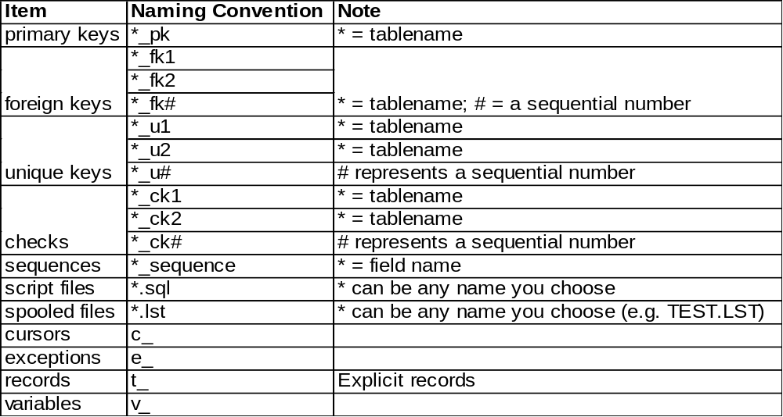
Key Concepts: Naming Conventions

Slide 58
SQL Statements
DML in PL / SQL
The DML statements permitted are:
  Select
  Insert
  Update
  Delete

Slide 59
DML in PL / SQL
Select
SELECT statement in PL/SQL retrieves data from a database table into:
  PL/SQL record
  set of PL/SQL variables
Using SELECT in PL/SQL should only return one row
When you need to retrieve more than one row from a table use a cursor

Slide 60
DML in PL / SQL
Select Syntax
  SELECT { * | select_list_item }
    INTO { PL/SQL_record | variables}
    FROM table_reference
    WHERE where_clause
each variable must be compatible with its associated select list item
count of variables must be same as number of items in list
record should contain fields that correspond to the select list in type and count

Slide 61
select.sql
DECLARE
v_StudentRecord students%ROWTYPE;
v_Department classes.department%TYPE;
v_Course classes.course%TYPE;
BEGIN
SELECT *
INTO v_StudentRecord
FROM students
WHERE id = 10000;
SELECT department, course
INTO v_Department, v_Course
FROM classes
WHERE room_id = 99997;
END;

Slide 62
DML in PL / SQL
Insert
The INSERT statement inserts data into a database table
There are two variations of the INSERT command
  add one row to a table using the specified VALUES list
  add one or several rows when the insert command uses a SELECT statement

Slide 63
DML in PL / SQL
Insert Syntax
  INSERT INTO table_reference
  [(column_names)]
  {VALUES (expression) | select_statement}
  use column names when the values
    are listed in a different order than as defined during table creation
    Only a portion of the columns of the table are used during insert
  table definition remains unchanged after the new row is inserted

Slide 64
DML in PL / SQL
Insert
The word VALUES must precede the list of data to be inserted
Regarding the values in the list:
  a character string must be in single quotes
  numbers can stand by themselves
  dates must be in single quotes
    In the default Oracle date format
    Converted using TO_DATE function (this is the suggested method)

Slide 65
Insert
Using Built-in Functions
You can modify the contents of the values before they are entered into a column of a table
  by a VALUES list
  from a SELECT statement
Use any of the built-in functions supported by PL/SQL
  character
  date functions
  numeric
  conversion

Slide 66
insert.sql
DECLARE
v_StudentID students.id%TYPE;
BEGIN
SELECT student_sequence.NEXTVAL
INTO v_StudentID
FROM dual;
INSERT INTO students (id, first_name, last_name)
VALUES (v_StudentID, 'Timothy', 'Taller');
INSERT INTO students (id, first_name, last_name)
VALUES (student_sequence.NEXTVAL, 'Patrick', 'Poll');
END;

Slide 67
DML in PL / SQL
Insert with Select
It is also possible to insert rows into a table using the results of a SELECT statement
The results of a SELECT statement
  can return one or several rows based on the WHERE clause
  can be a mix of columns from one or more tables

Slide 68
DML in PL / SQL
Update
Requires setting specific values for each column you wish to change
Specifying which row or rows to modify using a WHERE clause
You can use built-in functions in setting a value for the update

Slide 69
Update in PL / SQL
Embedded SELECT
It is possible to set values in an UPDATE by embedding a SELECT statement right in the middle of it
  SELECT has its own WHERE clause
  UPDATE has its own WHERE clause to affect the rows
You must be certain that the SELECT will return no more than one row

Slide 70
Embedded SELECT
BEGIN
UPDATE comfort set Midnight =
(SELECT temperature
FROM weather
WHERE city = ‘MANCHESTER’)
WHERE city = ‘WALPOLE’
AND SampleDate = TO_DATE (’22-DEC-1999’, ‘DD-MON-YYYY’);
END;

Slide 71
DML in PL / SQL
Delete
Removing a row or rows from a table
WHERE clause is necessary to removing only the rows you intend
DELETE without the where clause will delete all of the rows of a table

Slide 72
delete.sql
DECLARE
v_StudentCutoff NUMBER;
BEGIN
v_StudentCutoff := 10;
DELETE FROM classes
WHERE current_students < v_StudentCutoff;
DELETE FROM students
WHERE current_credits = 0
AND major = 'Economics';
END;

Slide 73
DML in PL / SQL
Truncate
Another command for deleting records from a table is the TRUNCATE command
    TRUNCATE TABLE students;
Does not operate the same as DELETE
  deletes all rows from a table
  cannot be rolled back
  records are unrecoverable
  does not run any DELETE triggers
  does not record any information in a snapshot log

Slide 74
DML in PL / SQL
WHERE Clause
The SELECT, UPDATE, and DELETE statements all include the WHERE clause
Defines the active set (set of rows):
  returned by a SELECT query
  Acted upon by an UPDATE or DELETE
Consists of conditions, joined together by the boolean operators AND, OR, and NOT
Conditions usually take the form of comparisons using the relational operators (such as: =, <>, >, >=, <, <=)

Slide 75
DML in PL / SQL
WHERE Clause with Cursor
The UPDATE, and DELETE statements both include a WHERE clause with a special syntax
  the WHERE CURRENT OF is used with a cursor definition
  often processing done in a fetch loop modifies the rows that have been retrieved by a cursor

Slide 76
DML in PL / SQL
WHERE Clause with Cursor
This method consists of two parts:
  the FOR UPDATE clause in the cursor declaration
  the WHERE CURRENT OF clause in an UPDATE or DELETE statement

Slide 77
forupdat.sql
DECLARE
v_NumCredits classes.num_credits%TYPE;
CURSOR c_RegisteredStudents IS
SELECT *
FROM students
WHERE id IN (SELECT student_id
FROM registered_students
WHERE department= 'HIS'
AND course = 101)
FOR UPDATE OF current_credits;

Slide 78
forupdat.sql (cont.)
BEGIN
FOR v_StudentInfo IN c_RegisteredStudents LOOP
SELECT num_credits
INTO v_NumCredits
FROM classes
WHERE department = 'HIS'
AND course = 101;
UPDATE students
SET current_credits = current_credits + v_NumCredits
WHERE CURRENT OF c_RegisteredStudents;
END LOOP;
COMMIT;
END;

Slide 79
DML in PL / SQL
Synonyms
It is possible to create a synonym for a:
  table
  view
  sequence
  stored
    procedure
    function
  package

Slide 80
DML in PL / SQL
Synonyms
The syntax for creating a synonym is:
  CREATE SYNONYM synonym_name FOR reference;
Where:
  synonym_name – name of your synonym
  reference – schema object being referenced

Slide 81
Pseudocolums
Currval and Nextval
CURRVAL and NEXTVAL are used with sequences
A sequence is an Oracle object used to generate unique numbers
Once created, you can access it with its name by:
  sequence.CURRVAL
  sequence.NEXTVAL

Slide 82
Pseudocolums
Currval and Nextval
Sequence values can be used in:
  SELECT list of a query
  VALUES clause of an INSERT
  SET clause of an UPDATE
Sequence values cannot be used in:
  WHERE clause
  PL/SQL statement

